Slide 1
SUM
MER
TEMPLATES
Font: https://fonts.google.com/specimen/Montserrat?
selection.family=Montserrat

Slide 2
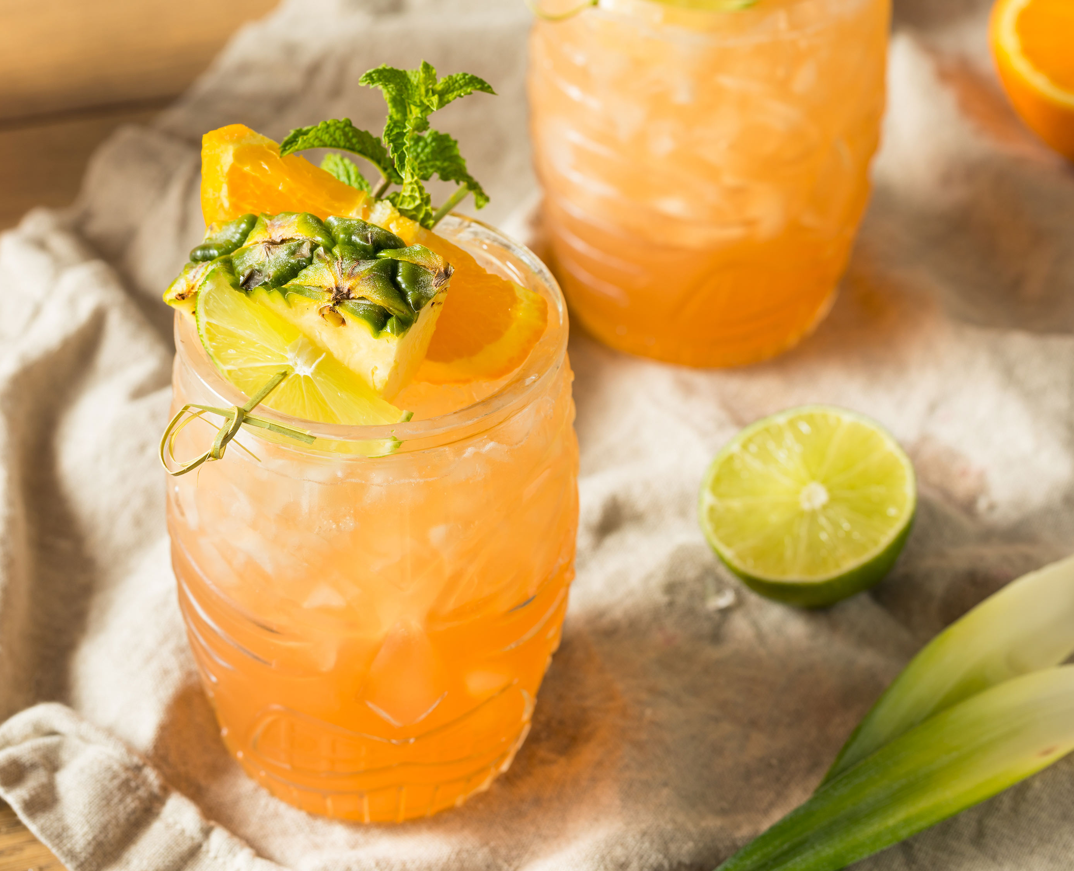
SUMMER
It´s always
summer at
DATABEAT.NET

Slide 3
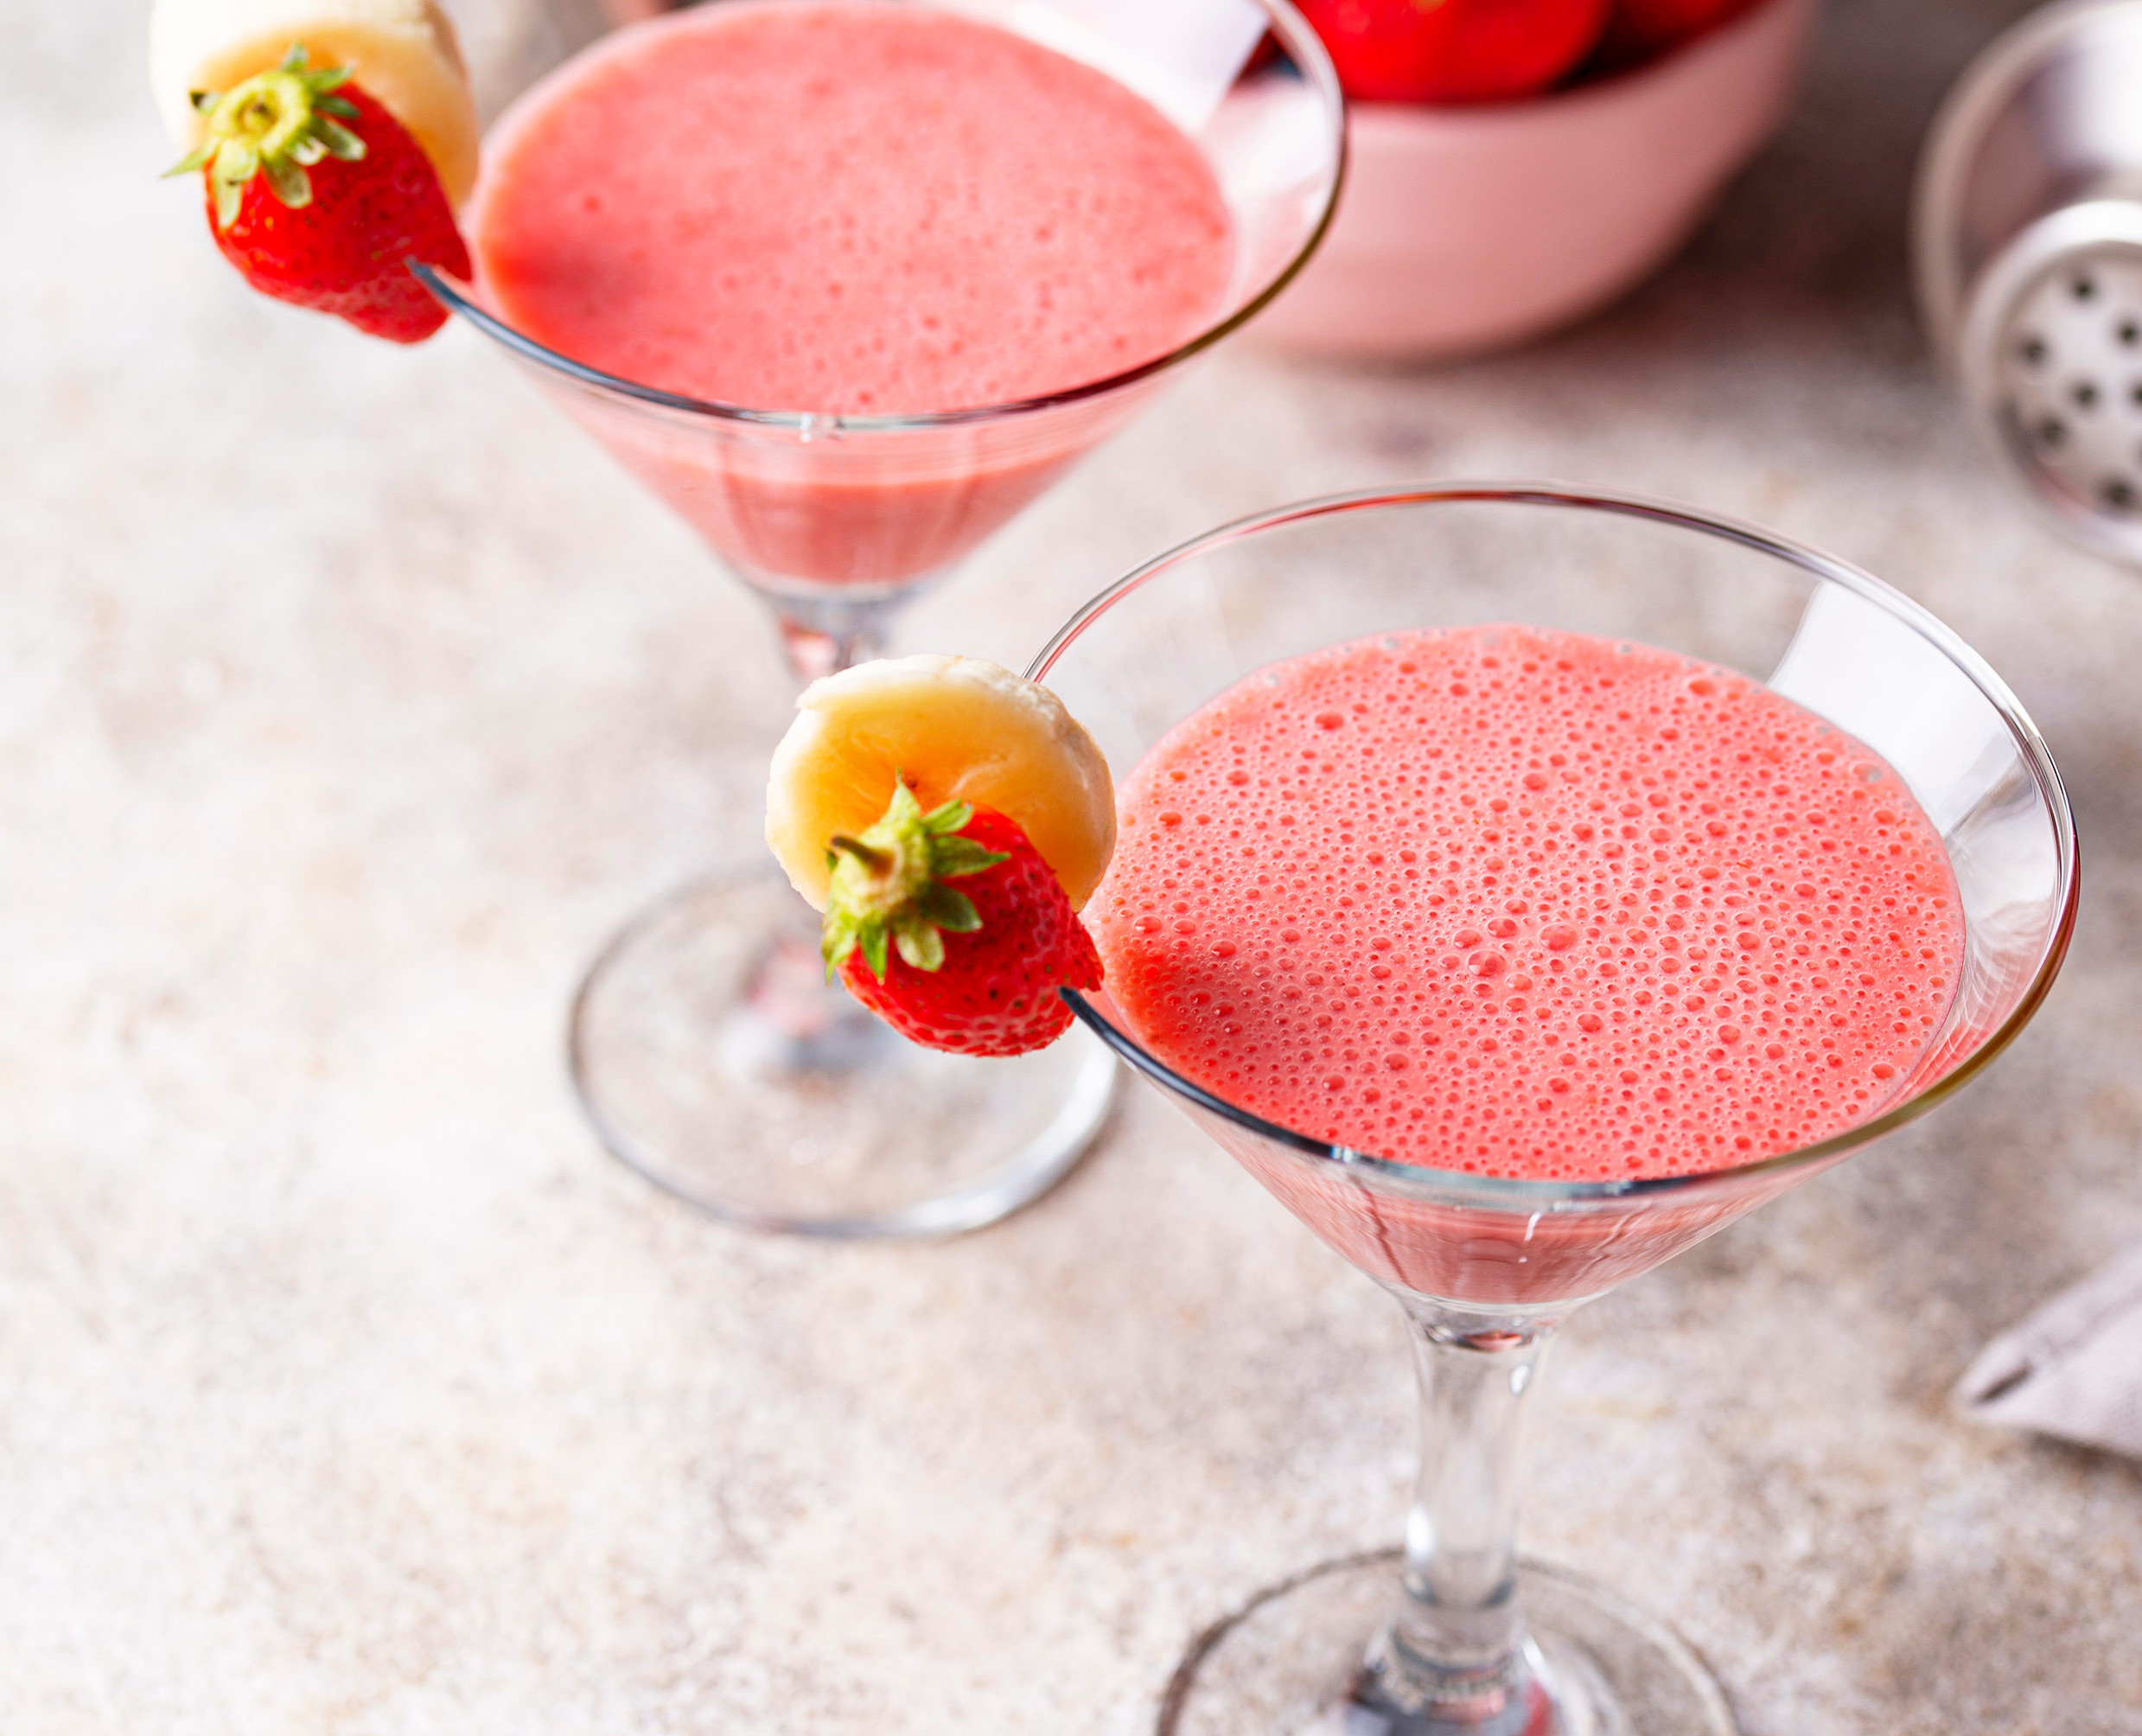
HAPPY
SUMMER
TO
YOU!
Go to our web site for more information!

Slide 4
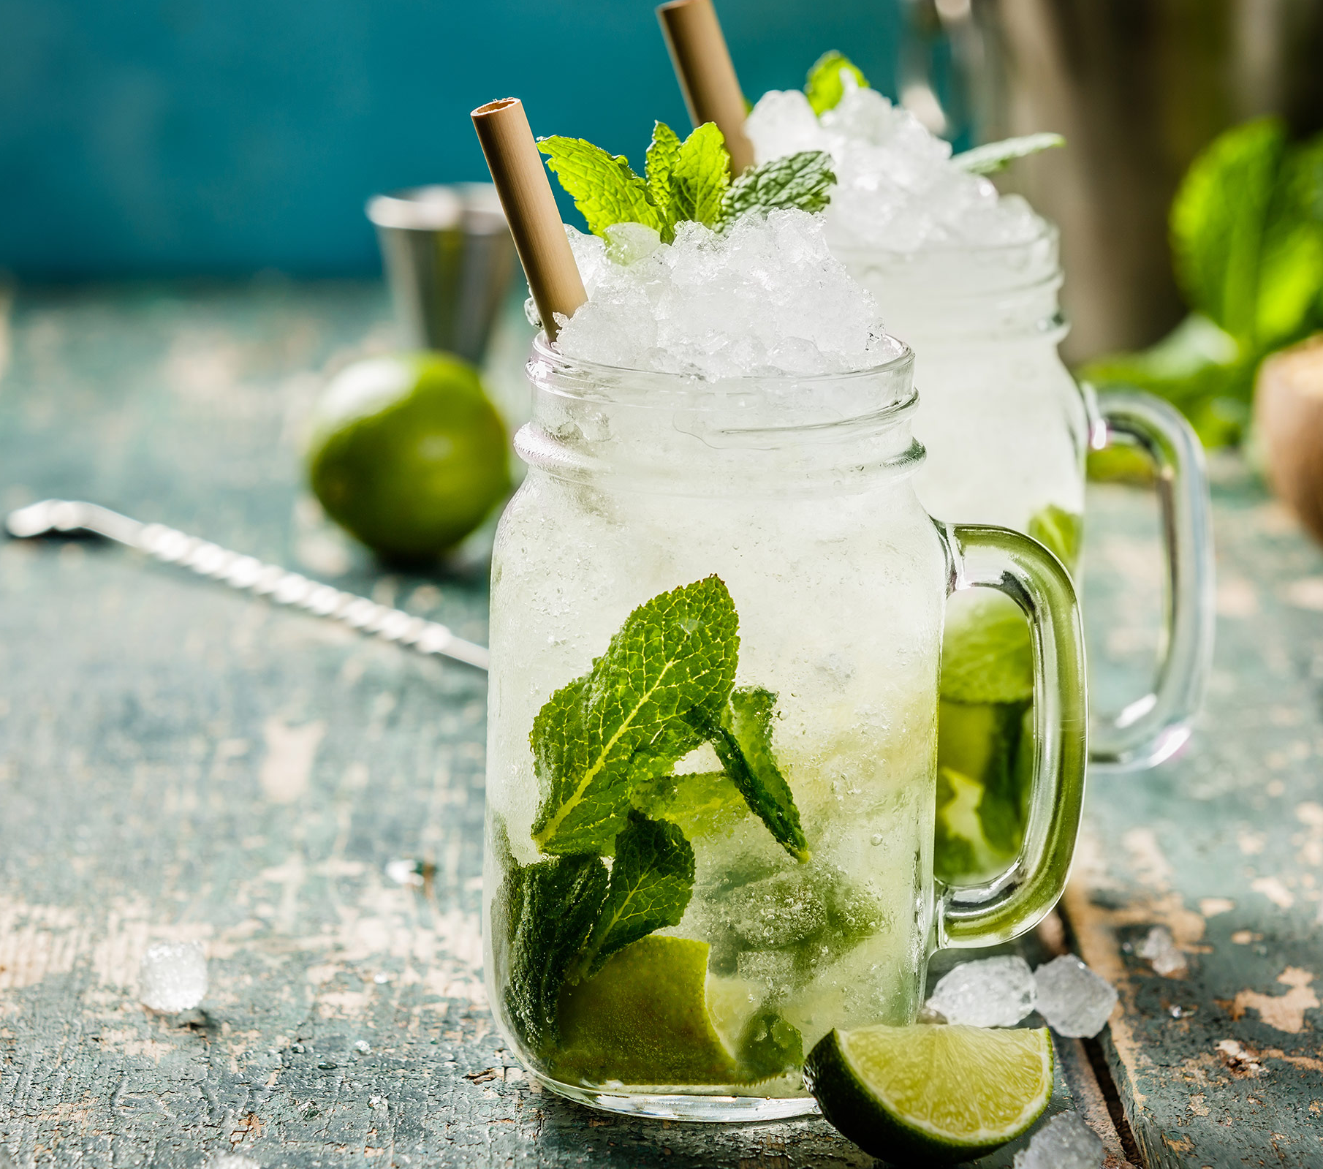
INGREDIENTS
10 large sprigs tarragon
2 lemons, thinly sliced
2 tablespoons sugar
3/4 cup gin
3/4 cup St-Germain
(elderflower liqueur)
1/3 cup fresh lemon juice
1 12-ounce can club soda

Slide 5
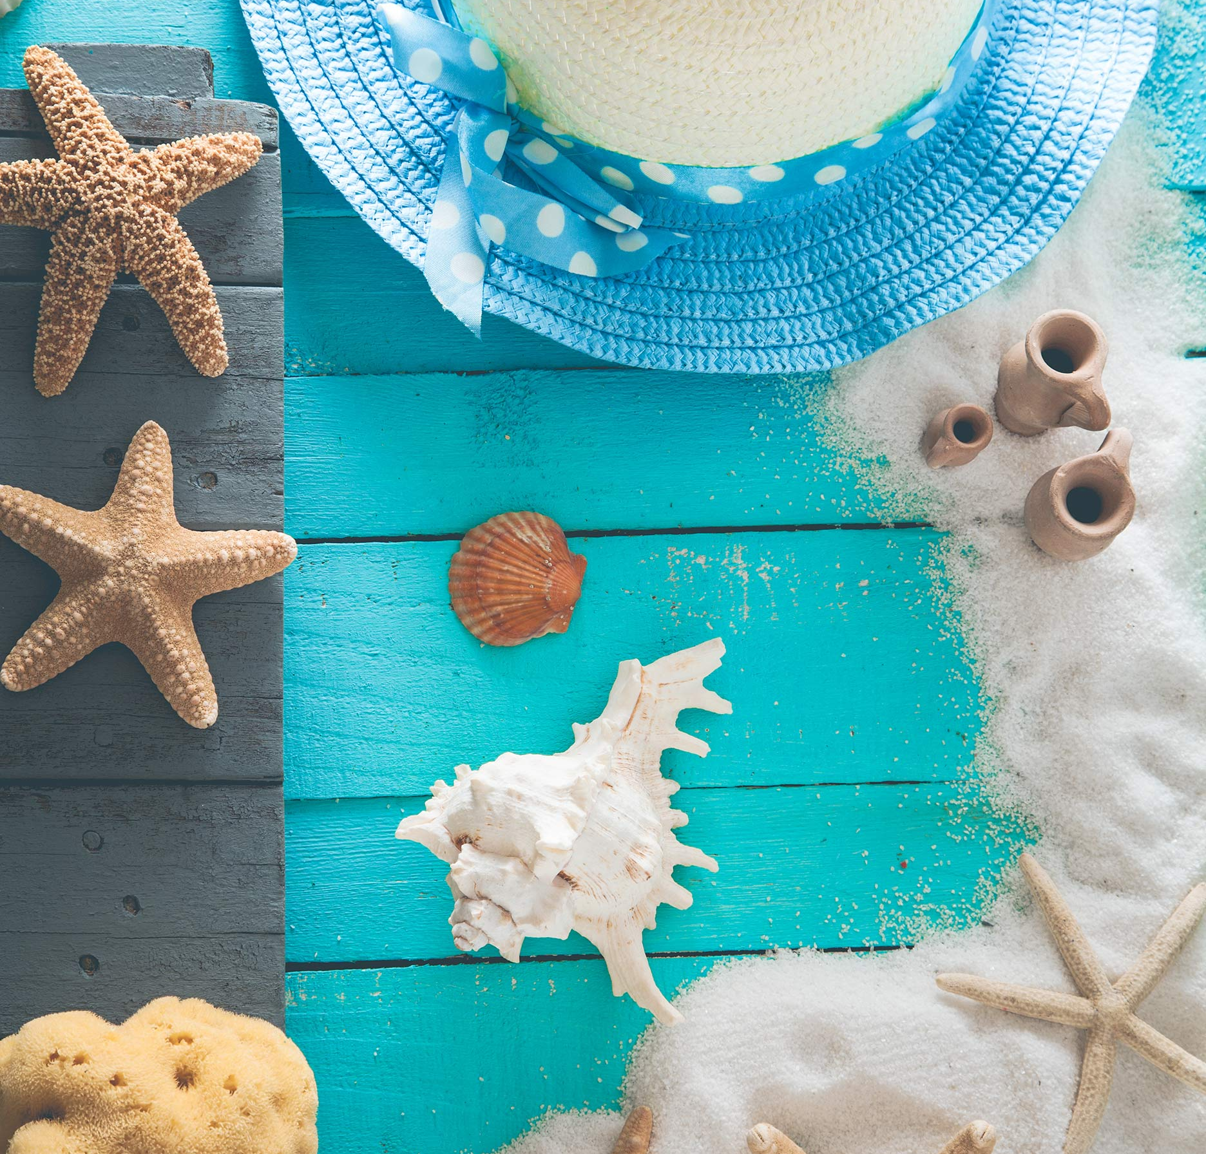
SUMMER
Do something cool with your summer.

Slide 6
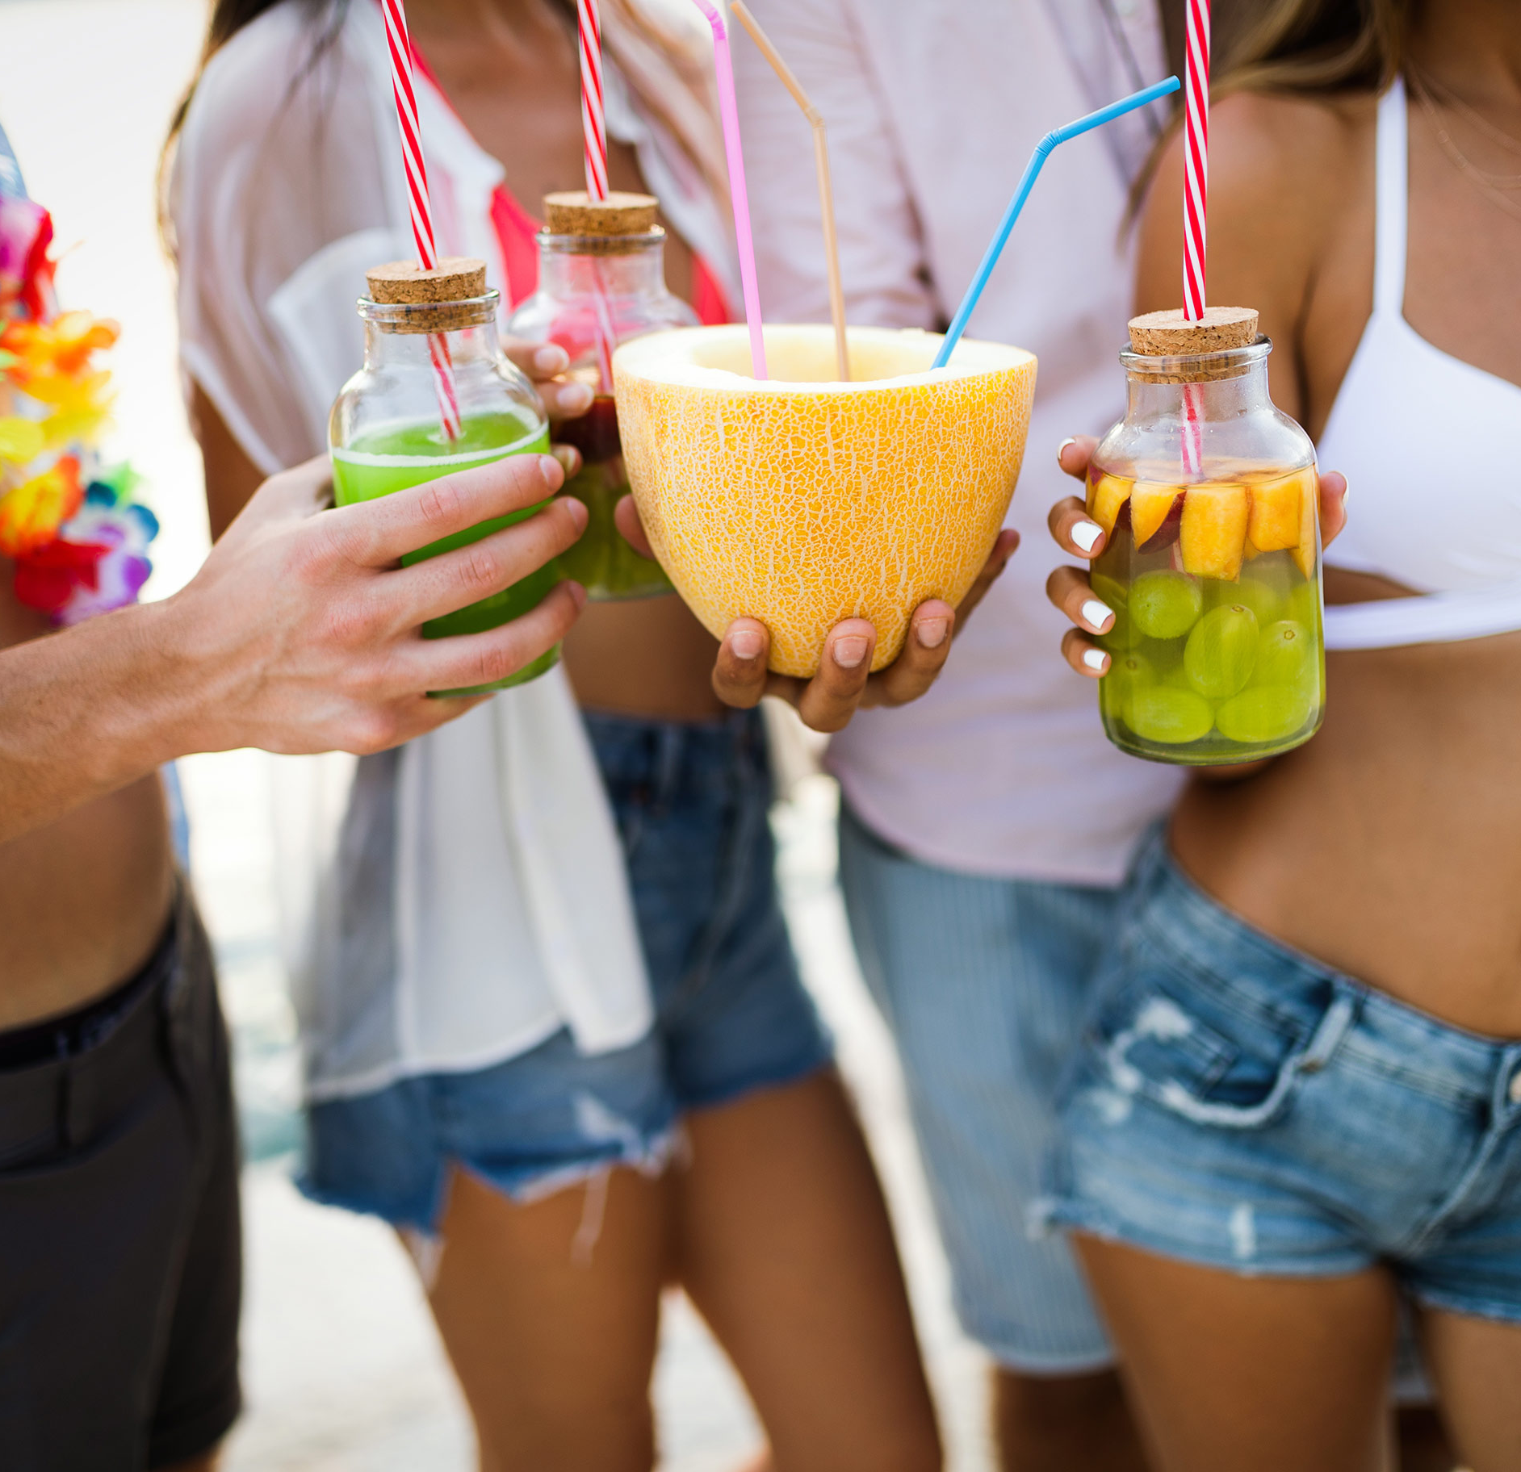
SUMMER
There's a drink for every mood
or occasion.

Slide 7





Go to our web site for more templates!
DATABEAT.NET
Follow us in Social media:

