Slide 1

Remember
VALENTINE`S
DAY
We have the gifts
Date: 14/2-2020

Slide 2
Happy Valentine´s Day
We have the gifts

Slide 3


Slide 4

Remember
VALENTINE`S
DAY
We have the gifts
Date: 14/2-2020
Notes:
4

Slide 5

VALENTINE`S DAY
Remember
We have the gifts!

Slide 6
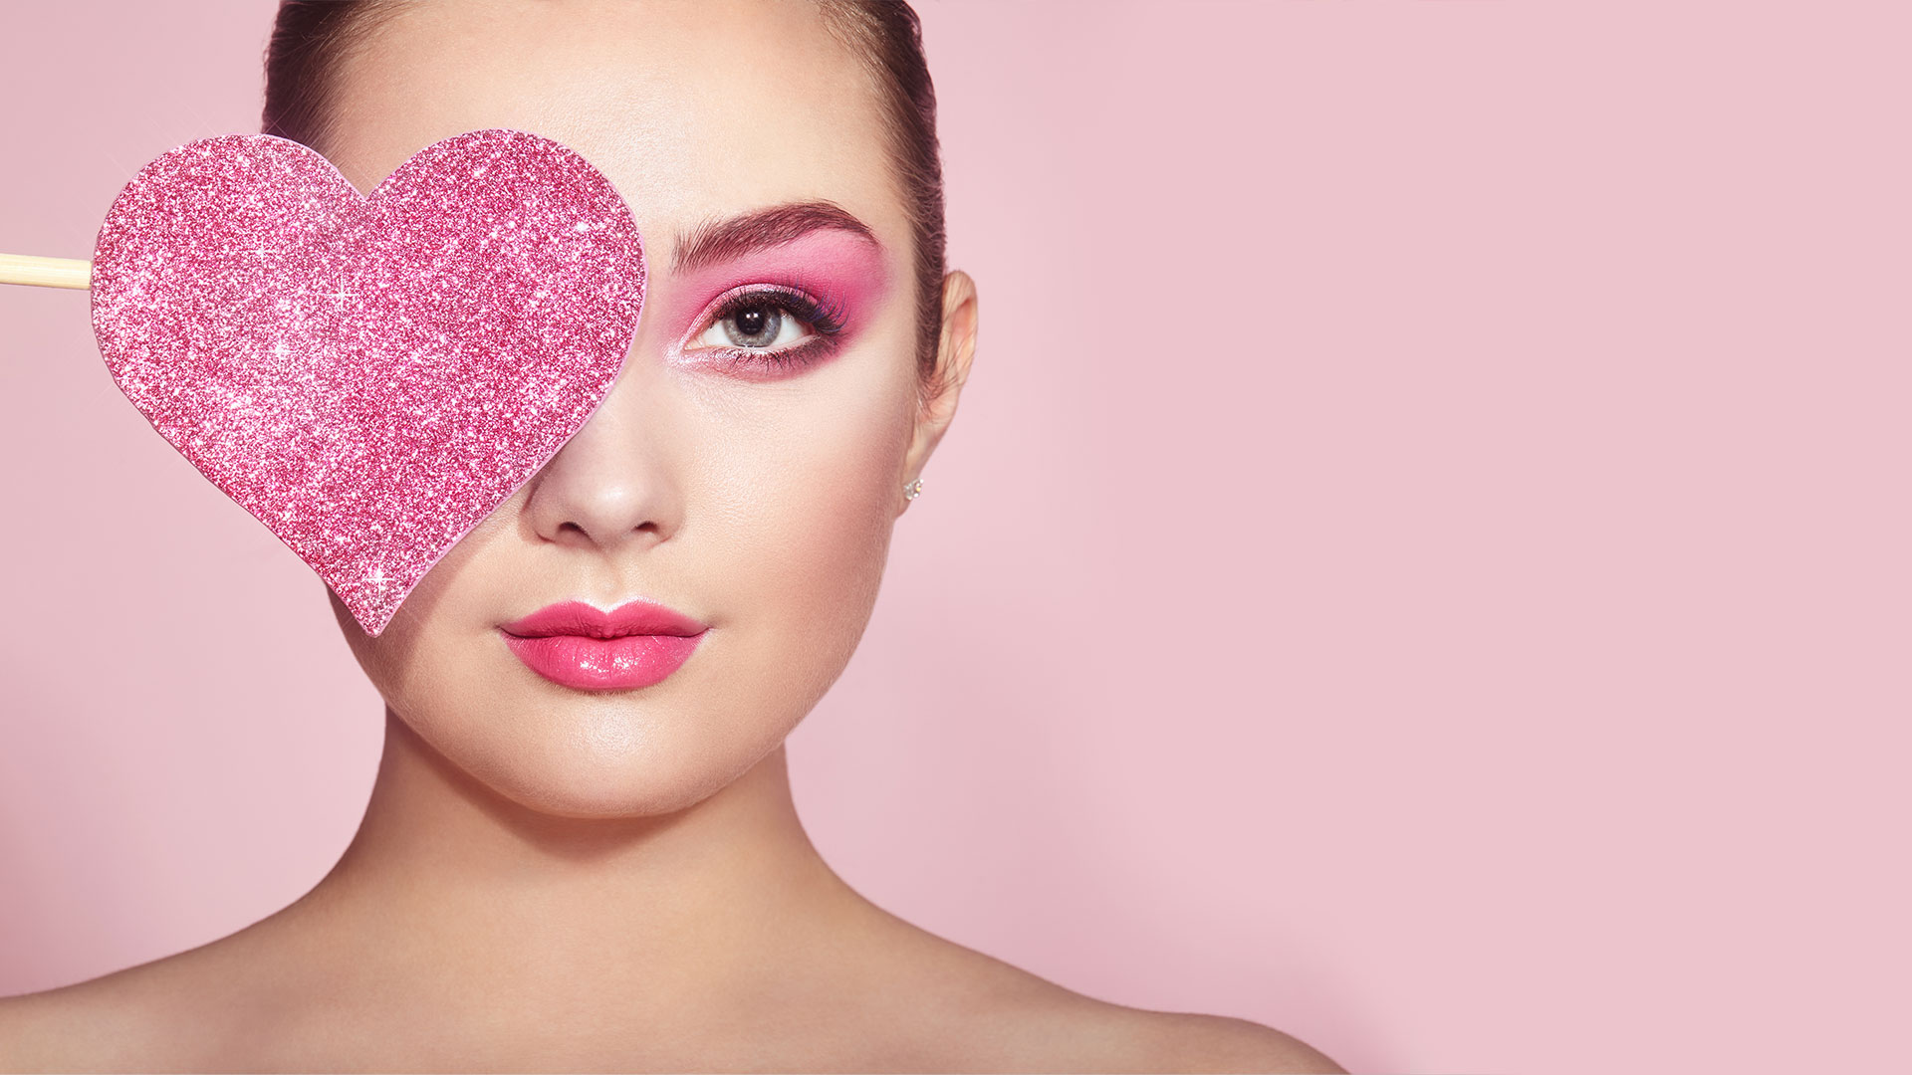


Slide 7


