Slide 1
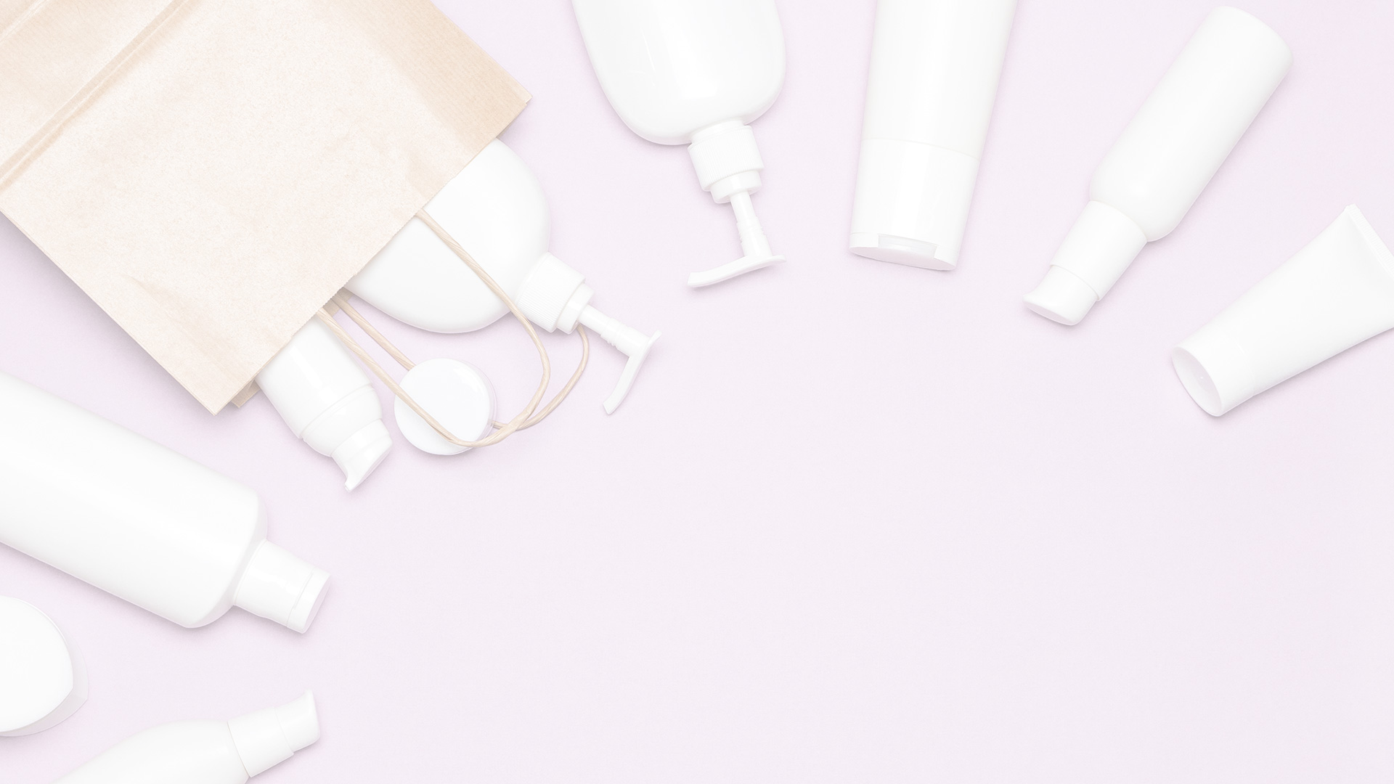
Same day delivery
Order now!

Slide 3
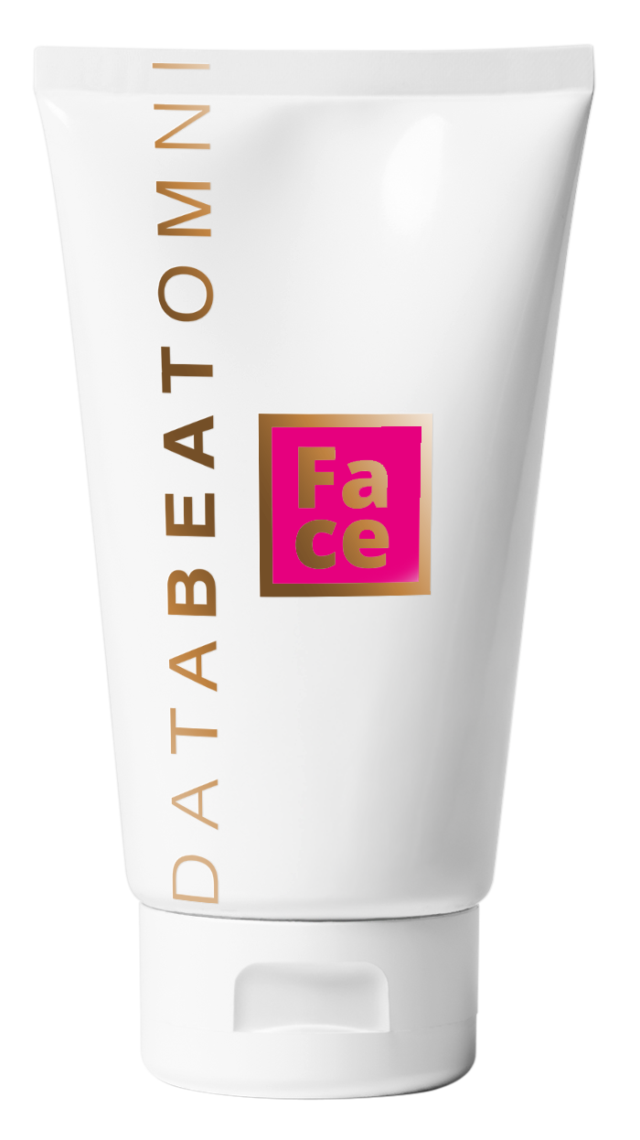
Best offer
Today!
98,-
Skin treatment

Slide 4

Organic products?
We have a collection of Norwegian high quality products.
Need more information? Visit our website:

Slide 5

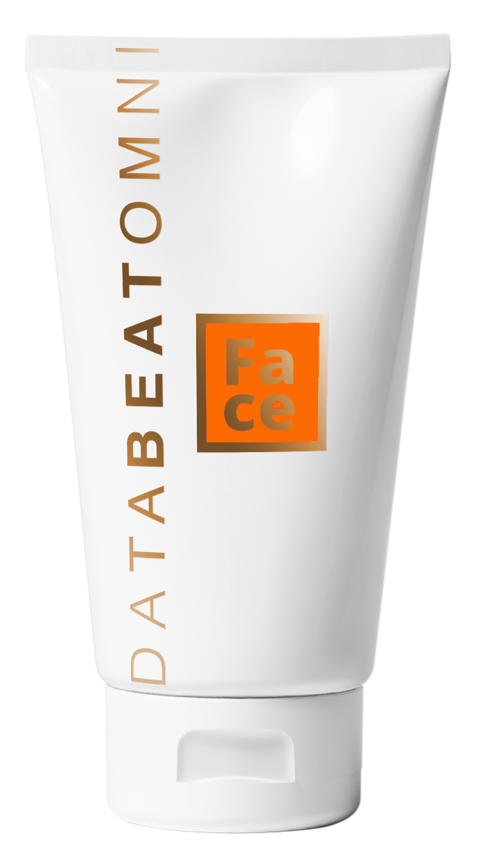
SUMMER TIP
Be prepared for sunny days!
2
1
FOR

Slide 6
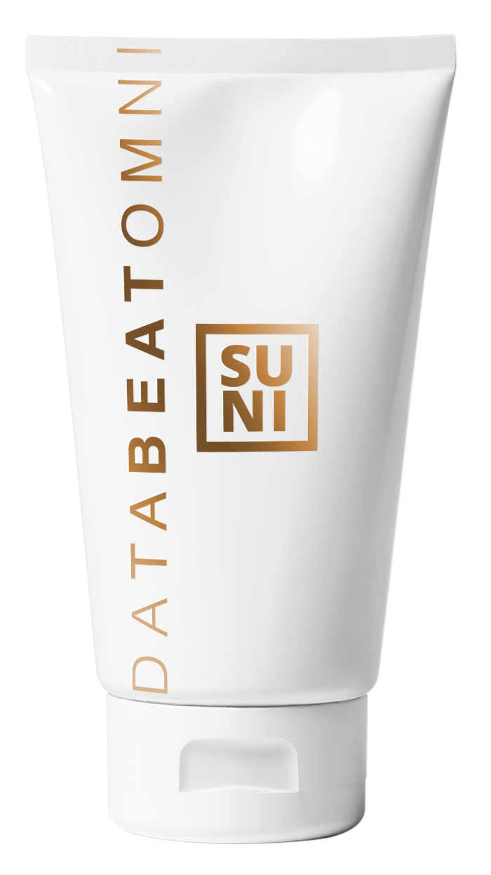
SUMMER TIP
Be prepared for sunny days!
Vannfast
solkrem
Waterproof
Sunscreen
98,-
Get it now!

Slide 7
Waiting for the
stork?
Door to door delivery
All of the strollers and other equipment
Get your delivery on the door the same
day you order

